Slide 1
CDD SKILL PROJECT
AUTOMATING WEBSITE USING DEVOPS TOOLS

Slide 2
TITLE: Automated Deployment of a Website Using Ansible, Docker, Kubernetes, and Shell Scripts
Team Members: 2200031007- Annepu Uday Kumar
2200032761- Suravarapu Deepthi
2200032642- Akkala Surya Venkata Deepak
Department Name: CSE-H
Guide Name: Swathi
Institution Name: KL University
Date: 29/04/2025

Slide 3
PROBLEM STATEMENT
Manual deployment and environment setup for web applications are often slow, inconsistent, and prone to errors. Lack of automation affects productivity and operational reliability. Using infrastructure automation tools like Ansible with containerization and orchestration through Docker and Kubernetes ensures faster, repeatable, and reliable deployments.

Slide 4
PROJECT OBJECTIVES
Automate the deployment of a website using infrastructure as code.
Use Ansible for server configuration and deployment automation.
Containerize the application using Docker for portability.
Orchestrate containerized services using Kubernetes.
Automate repetitive tasks with Shell scripts.

Slide 5
TOOLS & TECHNOLOGIES USED
Automation Tool: Ansible
Containerization: Docker
Container Orchestration: Kubernetes
Automation Scripts: Shell Scripts
Version Control: Git, GitHub
Operating System: Ubuntu/Linux

Slide 6
CI/CD PIPELINE ARCHITECTURE
Stages:
Developer pushes code to GitHub.
Ansible Playbook installs Docker, pulls images, and deploys containers.
Docker containers run the website services.
Kubernetes clusters manage and scale containerized applications.
Shell scripts automate Docker image builds, Kubernetes deployments, and health checks.
Diagram:
Code Commit → Ansible Playbook → Docker Image Build → Kubernetes Deployment → Live Website

Slide 7
IMPLEMENTATION DETAILS
Ansible Playbooks created for:
Installing Docker on target servers.
Pulling Docker images and running containers.
Automating Kubernetes cluster setup and deployments.
Dockerfile created to build the website image.
Kubernetes Deployment YAML for managing pods, services, and scaling.
Shell Scripts written to:
Build Docker images.
Push images to Docker Hub.
Apply Kubernetes configurations.
Monitor deployments and logs.

Slide 8
DEVOPS PRINCIPLES IN PROJECT
Infrastructure as Code: Ansible Playbooks and Kubernetes YAML.
Automation: Automated image builds, deployments, and scaling.
Containerization: Consistent environments via Docker.
Orchestration: Kubernetes for scaling and service management.
Continuous Feedback: Logs and health checks through Shell scripts and Kubernetes.

Slide 9
CHALLENGES FACED
Ansible SSH connection and privilege issues.
Docker container networking conflicts.
Kubernetes resource quota and service exposure issues.
Writing and debugging complex Shell scripts.
Managing Docker image versions and tags.

Slide 10
SKILLS ACQUIRED
Proficiency in Ansible Playbook creation and server management.
Dockerfile writing and container orchestration basics.
Kubernetes deployments, scaling, and service networking.
Shell scripting for automation and monitoring.
Troubleshooting complex DevOps environments.

Slide 11
RESULTS & OUTPUT
Deployment Success Rate: 100% after initial setup
Deployment Time: Reduced from 30+ minutes to under 2 minutes
Outputs:
Live Website: http://localhost:8080/
Docker Hub Repo: https://hub.docker.com/repository/docker/annepuudaykumar/index-page/general

Slide 12
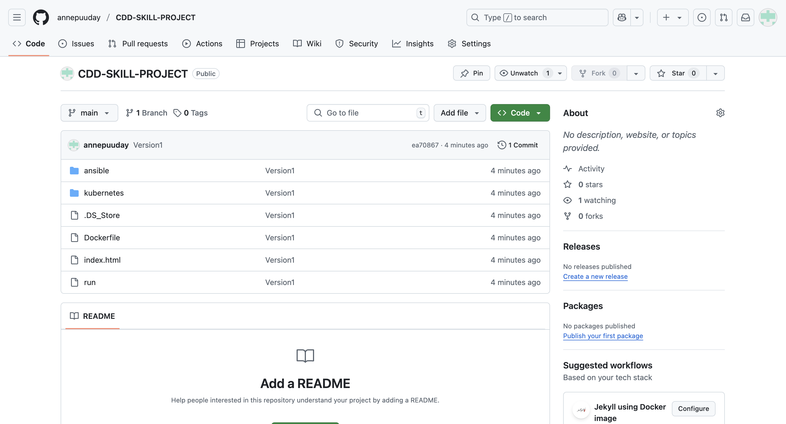

Slide 13
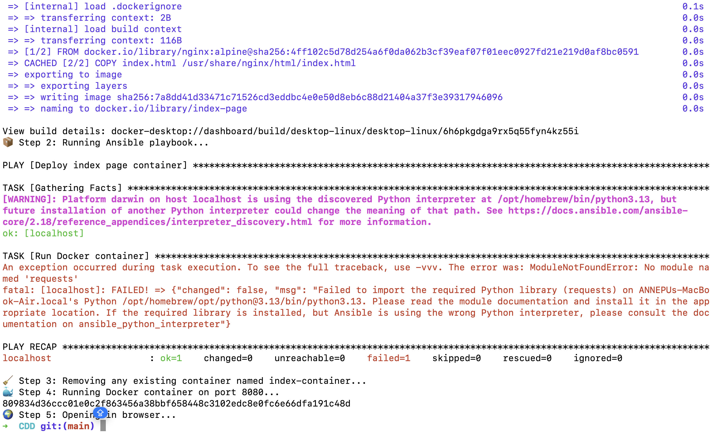

Slide 14
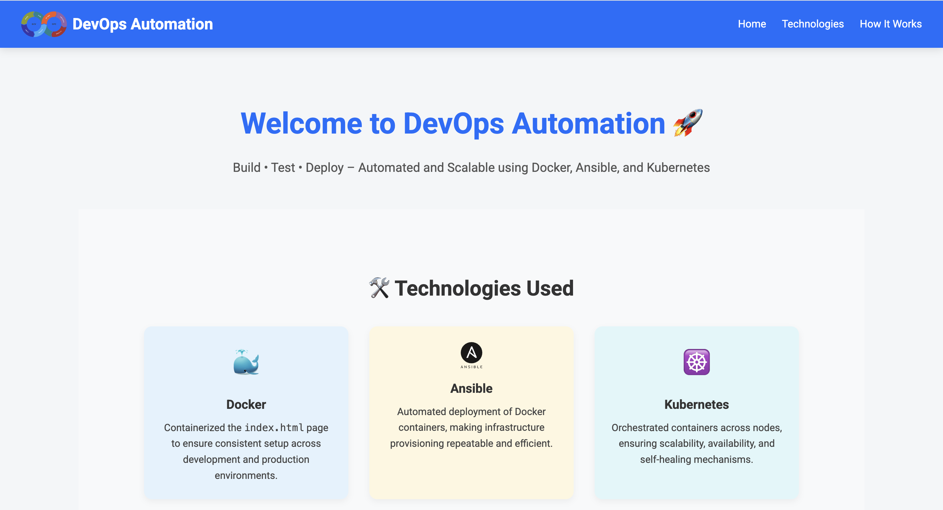

Slide 15
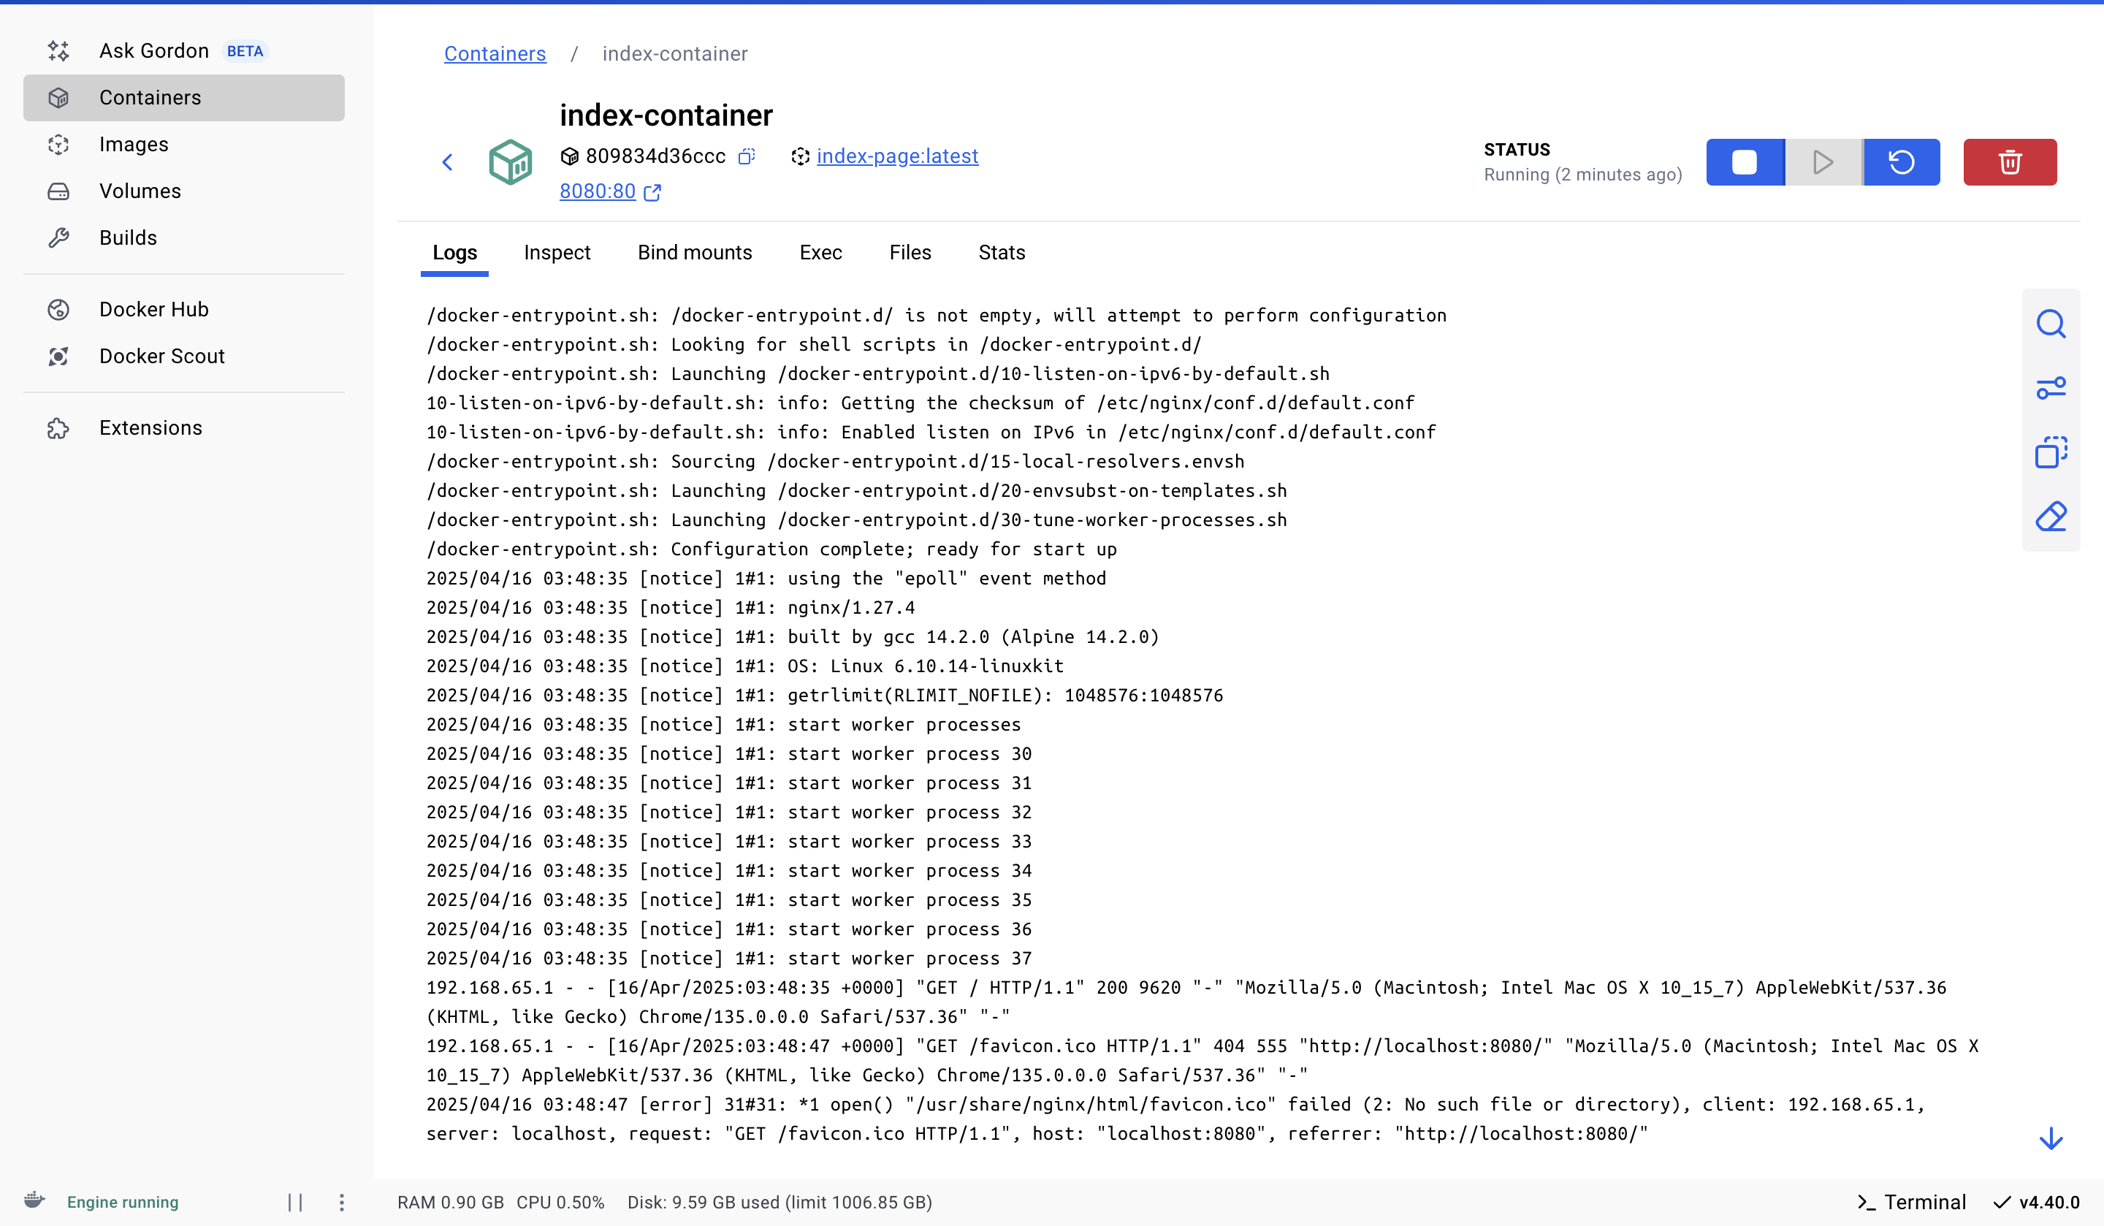

Slide 16
FUTURE SCOPE
Integrate CI/CD pipelines using Jenkins or GitHub Actions.
Add automated health checks and auto-scaling policies in Kubernetes.
Use Helm charts for managing complex Kubernetes deployments.
Deploy to cloud-native platforms like AWS EKS or Google GKE.

Slide 17
CONCLUSION
Learned end-to-end DevOps automation with Ansible, Docker, and Kubernetes.
Understood infrastructure as code and container orchestration benefits.
Gained hands-on experience in real-world deployment workflows.
Ready for advanced cloud-native and enterprise-grade DevOps projects.

Slide 18
Q&A
We welcome questions and feedback from the panel.

